Slide 1
Gene Sequence Analysis
Lecture 3: Multiple Alignment
02/06/2024
Phuc Loi Luu, PhD
Apdated from Dr. Morgan Langille

Slide 2
Importance of Similarity
Ancestral protein/gene sequence
Similar (homologous) protein/gene
sequences
Similar sequences: probably have the same ancestor, share the same structure, and have a similar biological function

Slide 3
Importance of Similarity
Sequence DB
unknown function ?
Similarity Search
similar protein
with known function
extrapolate
function

Slide 4
Importance of Similarity
Rule-of-thumb:
If your sequences are more than 100 amino acids long (or 100 nucleotides long) you can considered them as homologues if 25% of the aa are identical (70% of nucleotide for DNA). Below this value you enter the twilight zone.
Twilight zone = protein sequence similarity between ~0-20% identity: is not statistically significant, i.e. could have arisen by chance.
Beware:
E-value (Expectation value)
length of the segments similar between the two sequences
The number of insertions/deletions

Slide 5
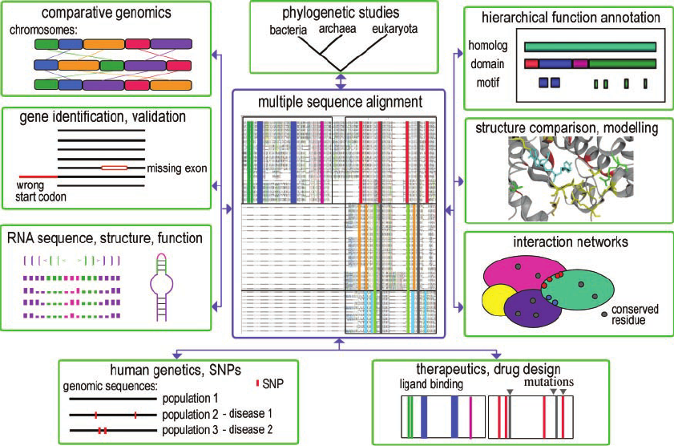
Examples of molecular biology applications (shown in green boxes) that rely on multiple sequence alignments
10.1093/nar/gki735

Slide 6
Outline
What is a multiple alignment?
Why do we need a multiple alignment? Characters of evolution
How to create multiple alignments? Editing Alignments
Viewing Alignments
●
●
●
●
●
●

Slide 7
What is a multiple alignment?
●
Simply an alignment of more than 2 sequences
●
Sequences are aligned globally (end to end)
●
Multiple Sequence Alignment (MSA) programs try to insert gaps in the sequences so that homologous characters are aligned

Slide 8
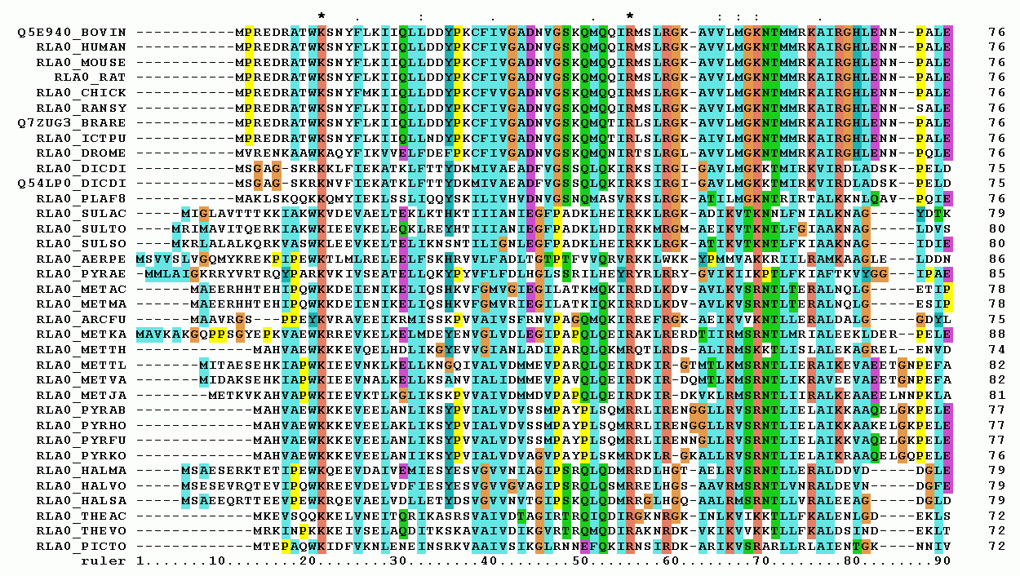
What is a multiple alignment?
https://en.wikipedia.org/wiki/Multiple_sequence_alignment

Slide 9
What to do with a MSA?
●
To look for sites of interest/conservation within a gene (motifs, binding sites, etc.)
●
To build phylogenetic trees
●
To identify positive selection

Slide 10
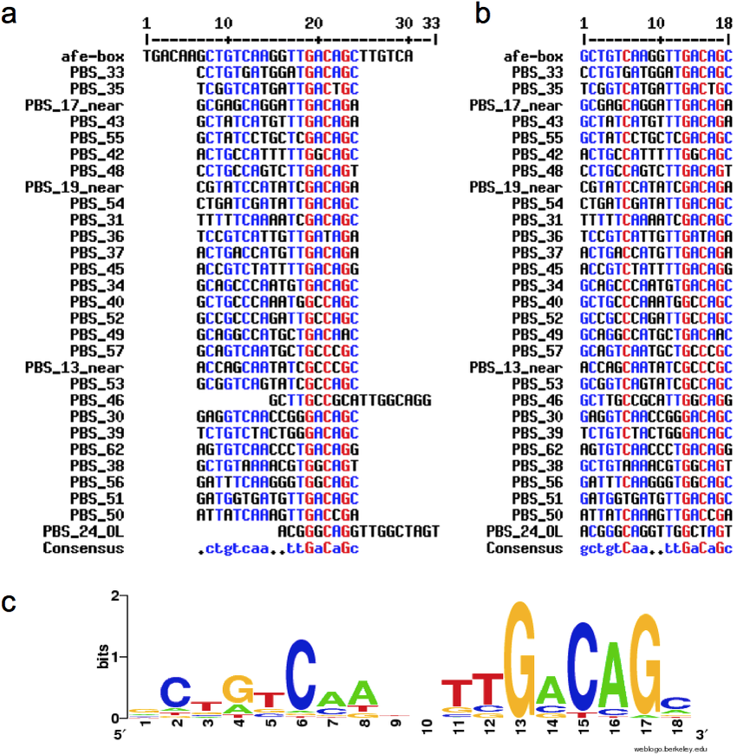
●
To look for sites of interest/conservation within a gene (motifs, binding sites, etc.)
(a) Alignment including the complete version of the afe-box (30 nucleotides); (b) Alignment including the central palindromic module of the afe-box (18 nucleotides). PBS_24_OL and PBS_46 align with better scoring to the right half of the complete afe-box. Numbers correspond to PBSs listed in Supplementary Table 1;
(c) Sequence logo file created from the sequence alignment shown in b.

Slide 11
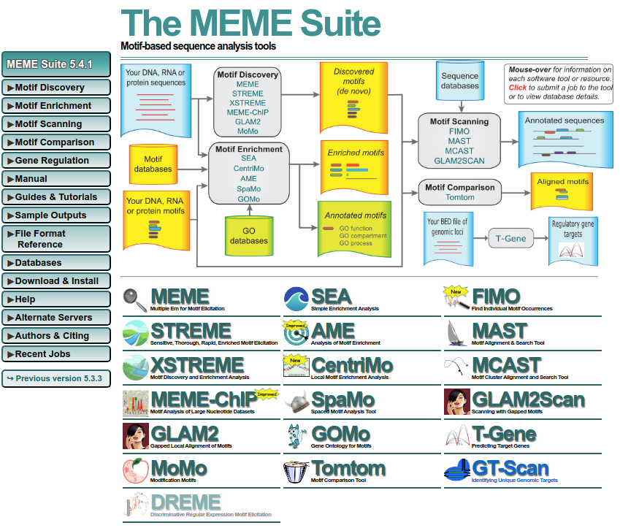
●
To look for sites of interest/conservation within a gene (motifs, binding sites, etc.)
https://meme-suite.org/meme/index.html

Slide 12
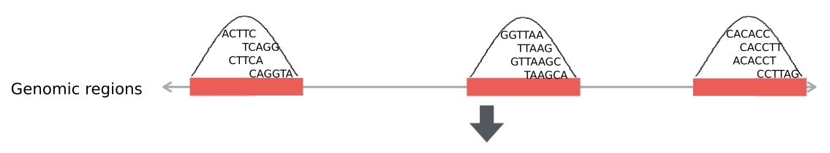
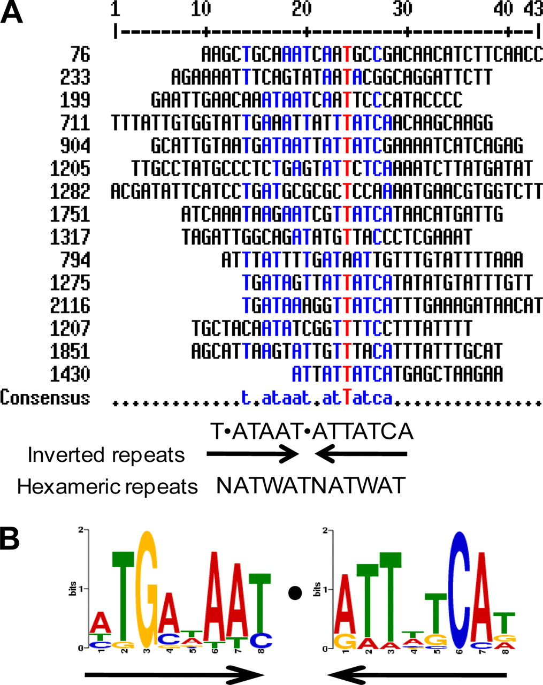
●
To look for sites of interest/conservation within a gene (motifs, binding sites, etc.)
Sequence Fasta file
Multiple Sequence Aligment
https://meme-suite.org/meme/index.html

Slide 13
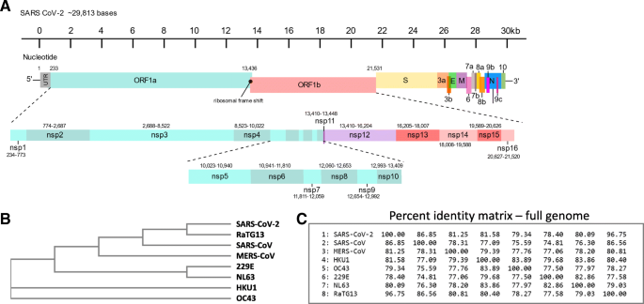
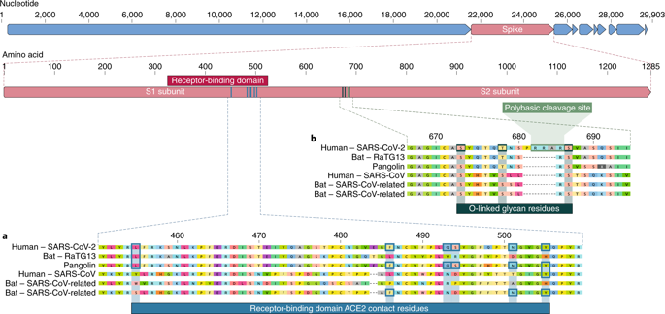
Reconstruct phylogenetic trees
10.1007/s40142-020-00197-5

Slide 14
Characters
●
Heritable changes in features (morphology, DNA sequence etc…)
●
The more similar characters you have, the more related you are

Slide 15
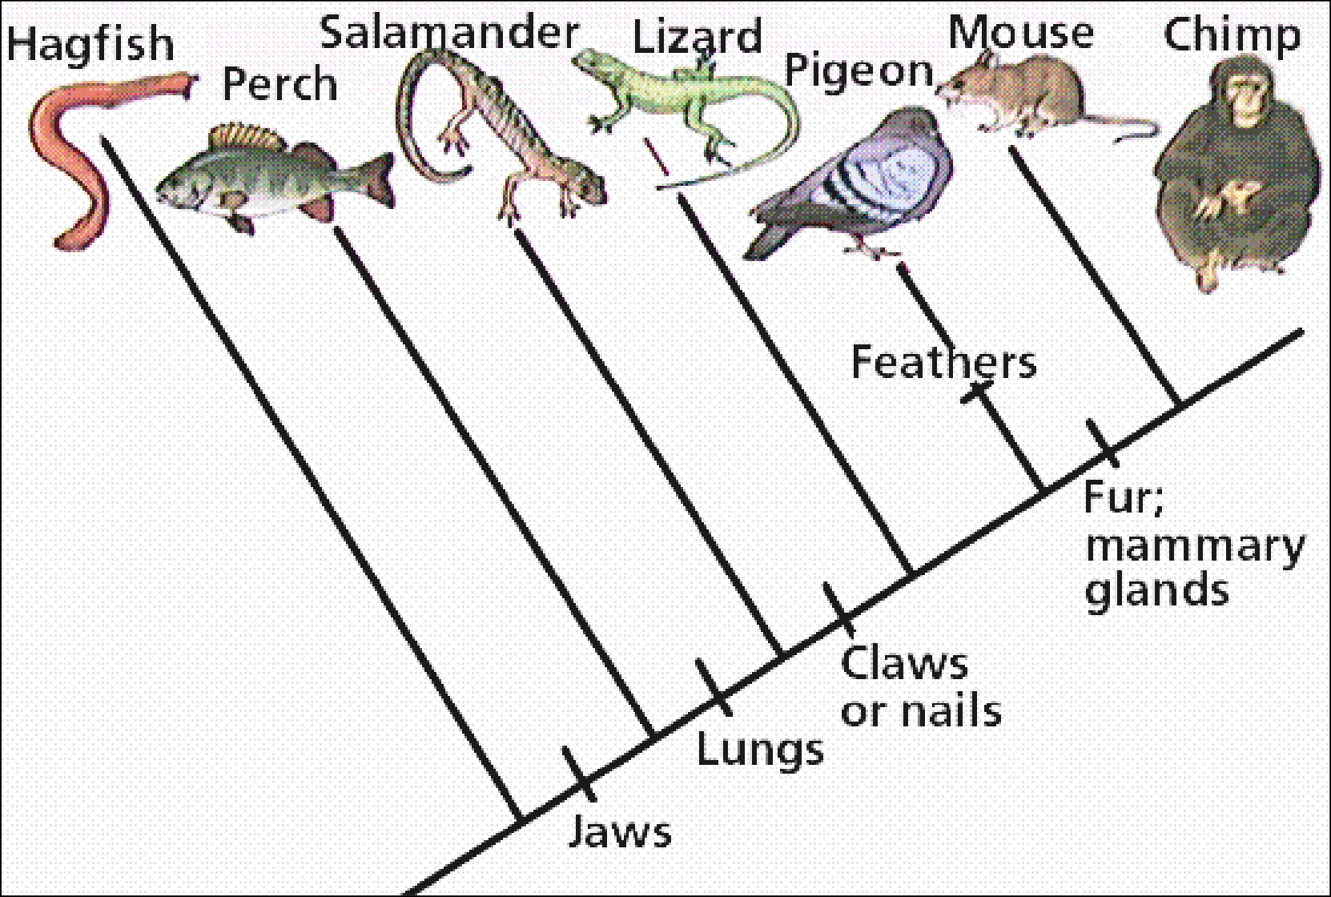
Evolution and characters
time

Slide 16
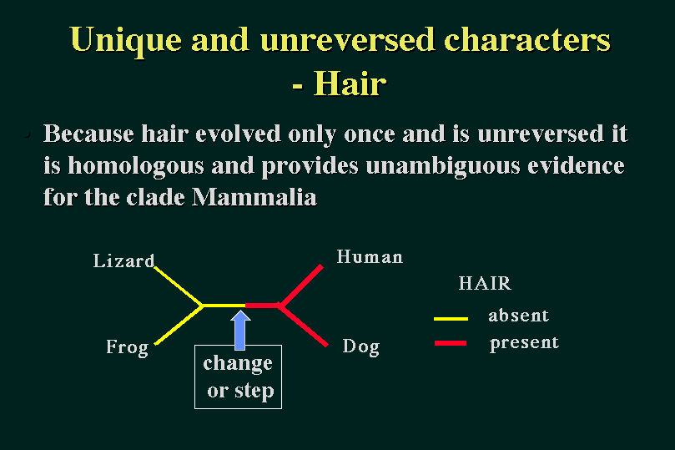
A Unique Character: Hair for Mammals
●
Hair evolved only once and is “unreversed”
Presence of hair is strong indication that organism is a mammal
●

Slide 17
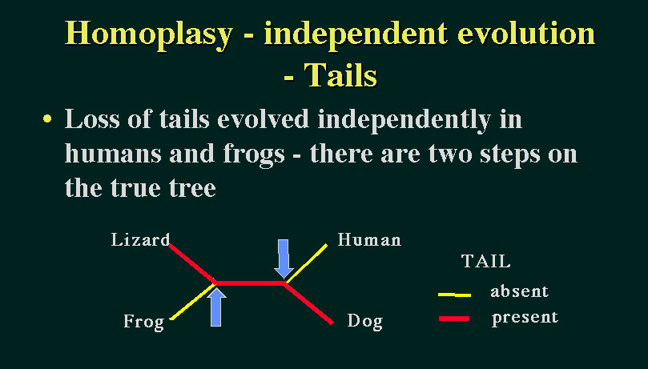
Homoplasy: The formation of tails
●
Tails evolved independently in the ancestors of frogs and humans
Presence of a tail is no useful conclusions
●

Slide 18
Classification according to characters – more characters can be good
 | Colour | Skin | Cost
Beef | red | no | $$$
Duck | red | yes | $$$
Pork | white | no | $$
Chicken | white | yes | $
Tofu | white | sometimes | $
Is Chicken most similar to Tofu?

Slide 19
Classification according to characters – increasing the number of characters
 | Colour | Skin | Cost | Legs | Feathers | Hair
Beef | red | no | $$$ | four | no | yes
Duck | red | yes | $$$ | two | yes | no
Pork | white | no | $$ | four | no | yes
Chicken | white | yes | $ | two | yes | no
Tofu | white | sometimes | $ | none | no | no

Slide 20
Evolution and characters – the importance of comparing characters with common origins (homologous)
bioinformatics bioinformatics bioinformatios oinformatios informatios information information
time

Slide 21
Evolution and characters
bioinformatics bioinformatics bioinformatios
--oinformatios
---informatios
---information
---information
Gaps represent non- homologous positions in the sequence.
time
They reflect the occurrence of insertions/deletions or other rearrangements during the evolutionary process.

Slide 22
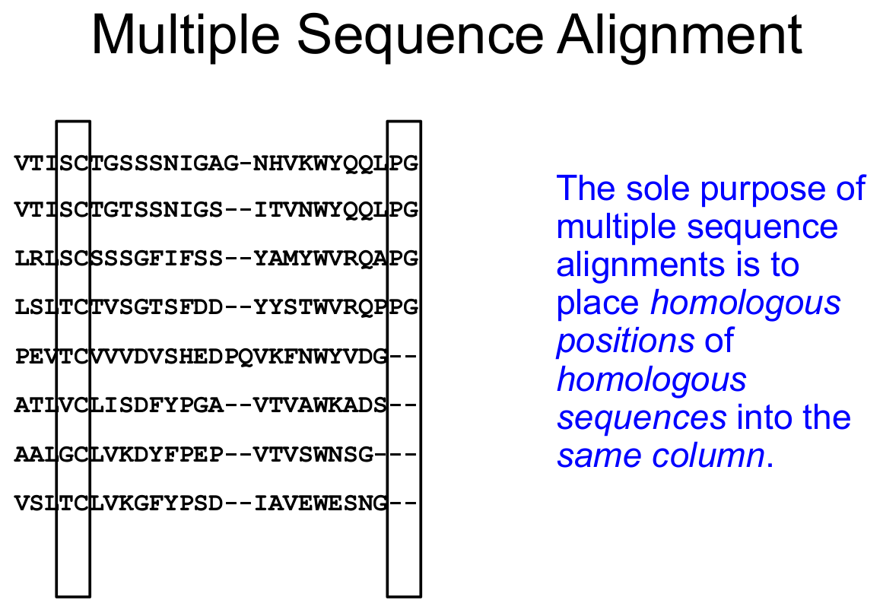

Slide 23
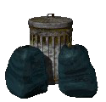
Multiple sequence alignments and phylogenetic analysis
First step in any phylogenetic analysis
Phylogenetic analysis only as good as the alignment
in --> out!

Slide 24
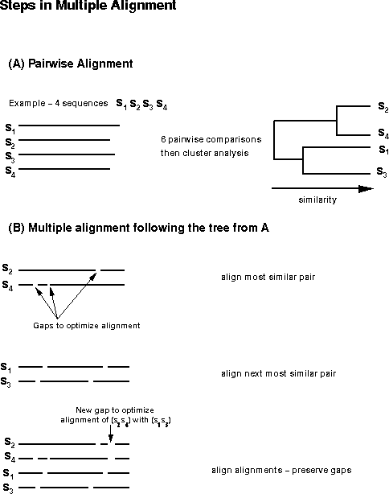

Slide 25
Creating a MSA
●
Clustal
Been around for ever and widely used ClustalW (command line)
ClustalX (GUI)
Also available on many web servers http://www.clustal.org/clustal2/
●
●
●
●
●
●
Muscle
Faster and maybe more accurate than Clustal
Command line only
There are web servers http://www.ebi.ac.uk/Tools/msa/muscle/
●
●
●
●
T-Coffee
Most accurate, but also the slowest
Also has special variations for RNA, protein structure, etc.
●
●
●
http://tcoffee.crg.cat/
16

Slide 26
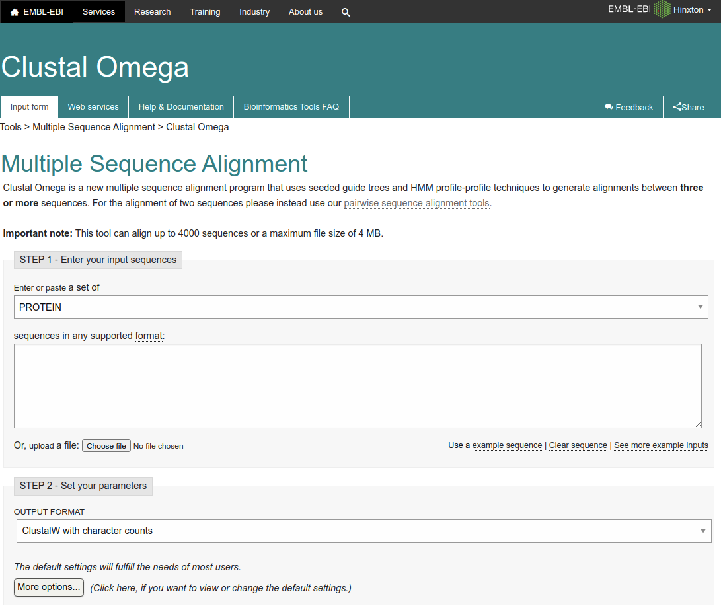
Need something faster
Clustal Omega: HMM Based
http://www.clustal.org/omega/
●
●

Slide 27
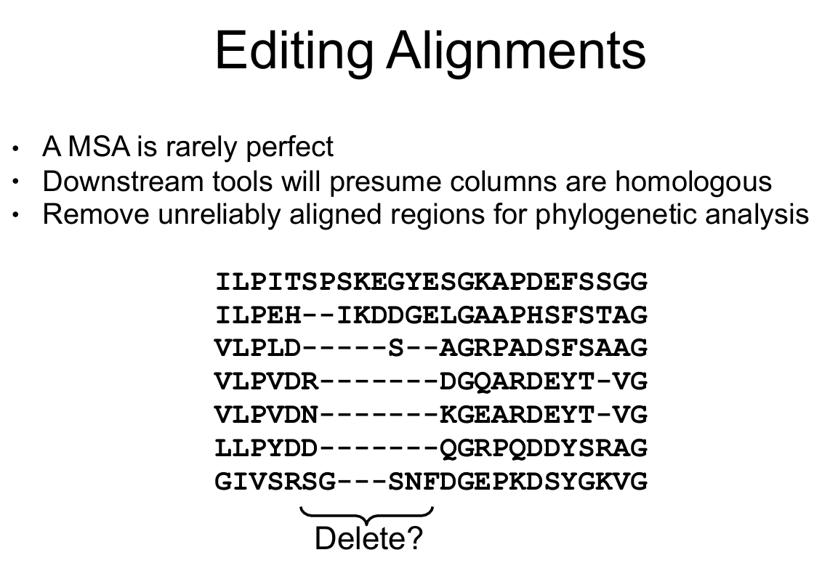
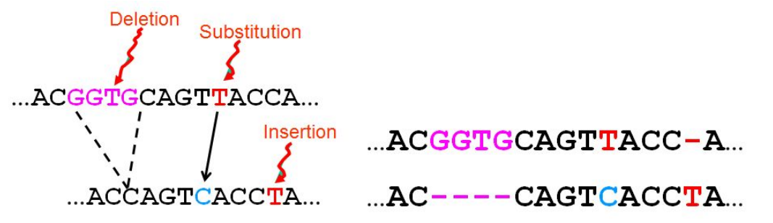

Slide 29
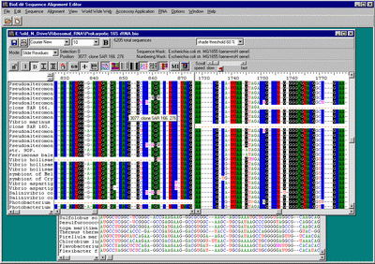
BioEdit: a biological sequence alignment editor
An intuitive multiple document interface with convenient features
Several sequence manipulation and analysis options and links to external analysis
https://bioedit.software.informer.com/7.2/

Slide 30
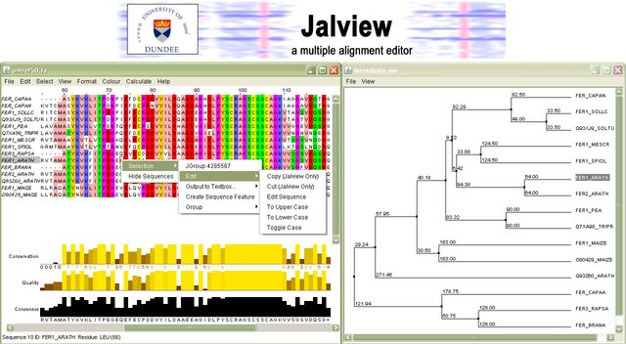
JalView: Manual
http://www.pdg.cnb.uam.es/cursos/CNB2013_seq/UsingJalView.html
http://www.jalview.org/

Slide 31
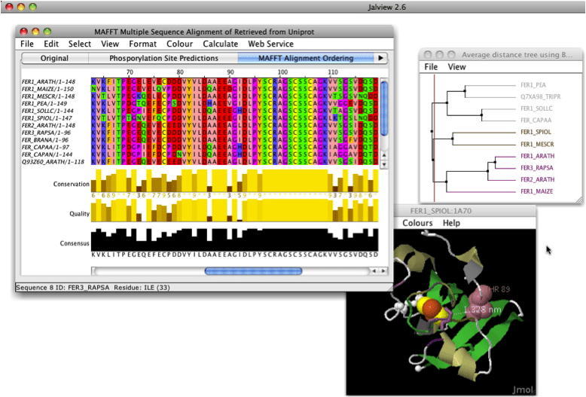
JalView: Manual
http://www.pdg.cnb.uam.es/cursos/CNB2013_seq/UsingJalView.html
http://www.jalview.org/

Slide 32
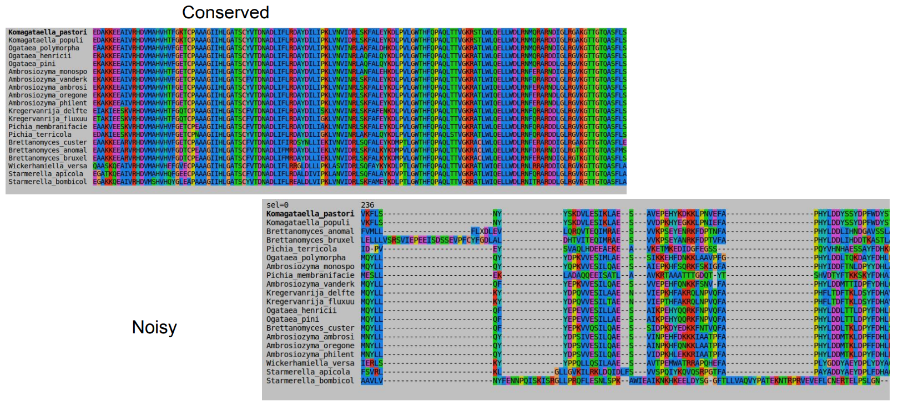
GBlocks: Automatic
http://molevol.cmima.csic.es/castresana/Gblocks.html
http://molevol.cmima.csic.es/castresana/Gblocks_server.html

Slide 33
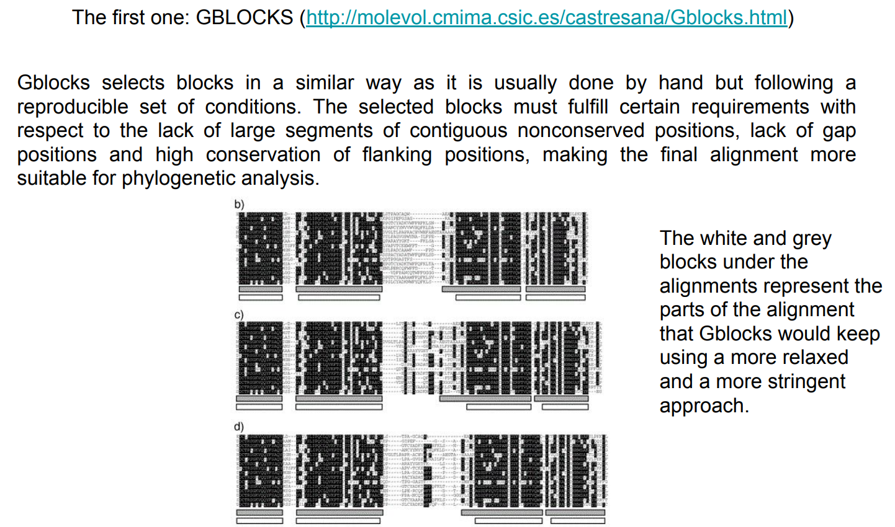
http://molevol.cmima.csic.es/castresana/Gblocks.html
http://molevol.cmima.csic.es/castresana/Gblocks_server.html

Slide 34
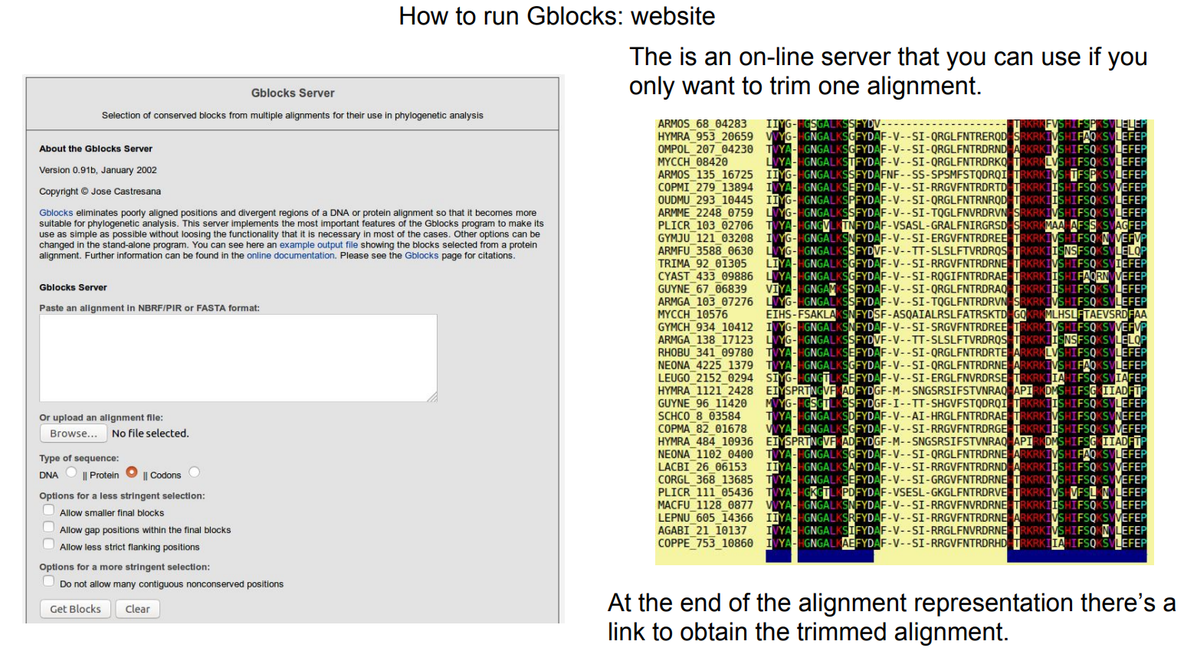
GBlocks: Automatic
http://molevol.cmima.csic.es/castresana/Gblocks.html
http://molevol.cmima.csic.es/castresana/Gblocks_server.html

Slide 35
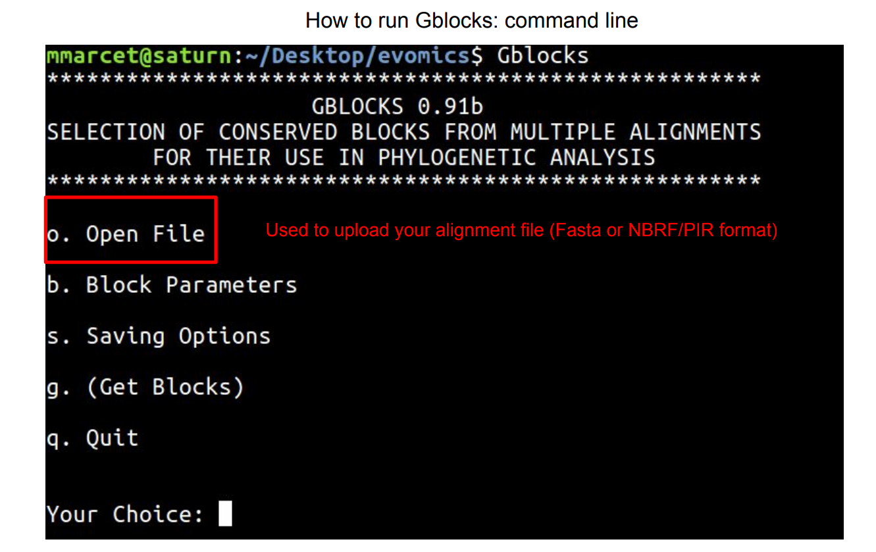
http://molevol.cmima.csic.es/castresana/Gblocks.html
http://molevol.cmima.csic.es/castresana/Gblocks_server.html

Slide 36
